Slide 1
Zoom Tips & Tricks for Dress for Success
Minnesota Chapter – January 2022

Slide 2
Dell Technologies is a destination employer for women, where everyone drives to create an inclusive environment, and women are enabled to achieve their goals at each point in their journey.
VISION
MISSION
Build an inclusive community that provides development, leadership and networking opportunities designed to empower, retain and attract women.
PILLARS
Leadership and professional development, brand advocacy and business impact, community engagement, women in technology and culture.
Minnesota Chapter– since September 2018
107
members
Leadership opportunities
Professional development
Community service credits

Slide 3
Agenda
Zoom Basic Features
Q&A
Zoom Advanced Features
Zoom Additional Resources

Slide 4
Basic Features

Slide 5
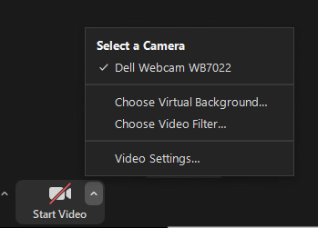
Zoom – Virtual Background
In a meeting, click the arrow next to Start Video
Select “Choose Virtual Background”
How to change your background in Zoom desktop:
In the zoom app on your computer
click your profile in the upper right-hand corner and click Settings.
In the menu on the left side, click Background & Filters.
Choose one of the default backgrounds
Want to use a custom image for your background? Click the + icon to upload an image.
This opens a box allowing you to upload a photo from your computer. You will now see it in the list of images you can choose.

Slide 6
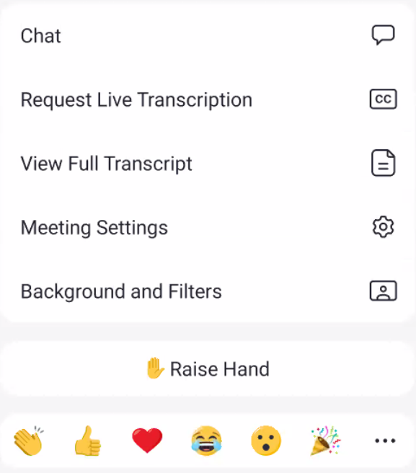
Zoom – Virtual Background
How to change your background in the Zoom mobile app:
When you login and join a meeting, tap the three dots at the bottom right-hand corner to open the More menu.
Tap Background and Filters
Select an image to use as your background or click the + to upload one from your phone.
Set the options to apply this to all meetings and or mirror your video.

Slide 7
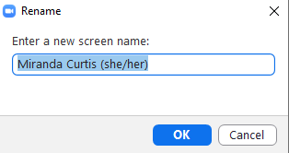
Zoom – Changing your name
To change your name in Zoom desktop:
In a meeting, you can hover on your name in the participants list and click More.
Select Rename and type the name you want displayed.
To permanently change it for all meetings:
Open the zoom desktop app and click the settings cog in the upper right-hand corner.
On the General tab, click View More Settings at the bottom.
Click Profile on the web page that opens and then click Edit on the right-hand side next to your name.
Enter in the name you want to show in meetings in the Display Name field and click Save.
1
2
3

Slide 8
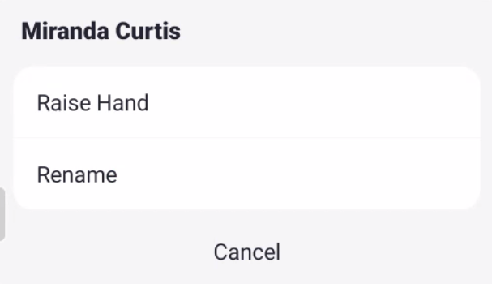
Zoom – Changing your name
To change your name in the Zoom mobile app:
When you are joining a meeting, it will ask for your name.
If you need to change it after you join:
click Participants, click your name, and click Rename.
Type in the name you want to display and click OK.
1
2
3

Slide 9
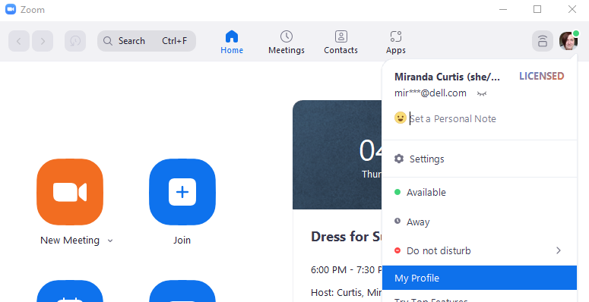
Zoom – Add a profile picture
In Zoom desktop:
Open the Zoom app and click your profile in the upper-right hand corner.
Choose My Profile from the menu. This will open a web browser to your profile.
Click on the picture icon next to your name.
Click Change on window that opens and select the image on your computer to use and click Open.
Adjust the size and click save. Picture must be smaller than 2 MB to upload.
1
2

Slide 10
Zoom – Add a profile picture
In Zoom mobile:
Open the app on your phone and click on Settings and then click your name at the top.
Click Profile Photo, then select choose a photo to use one on your phone or take a new photo.
Crop the photo as you would like and click Done or Save depending on your phone.
1
2
3
4

Slide 11
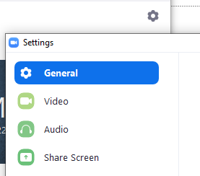
Zoom – Set default audio and video settings
Zoom desktop:
Open the Zoom app
Click on the Settings cog in the upper-right hand corner.
Click on Video in the left frame to choose your video settings
Click on Audio in the left frame to choose your audio settings
Zoom mobile:
Open the Zoom app and click on Settings.
Click on Meeting
Audio and Video settings are located here.
Note: You can mute/unmute your audio with the space bar.

Slide 12
Zoom – Filters
Zoom desktop:
Open the Zoom app and Click on the Settings cog in the upper right-hand corner.
Click on Background & Filters in the left frame.
Click on Video Filters and choose any that you would like to use.
In a meeting, Click the arrow next to Start Video
Select “Choose Video Filter”
Zoom mobile:
Once in the meeting, click More, then click Background and Filters.
Click Filters and choose the one you would like to use.
If you want to apply to all future meetings click the button Apply to all meetings.
Click the X to close the window and go back to the meeting.

Slide 13
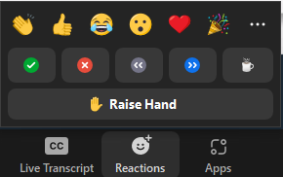
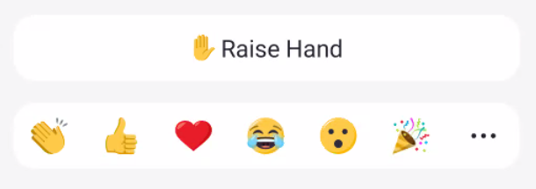
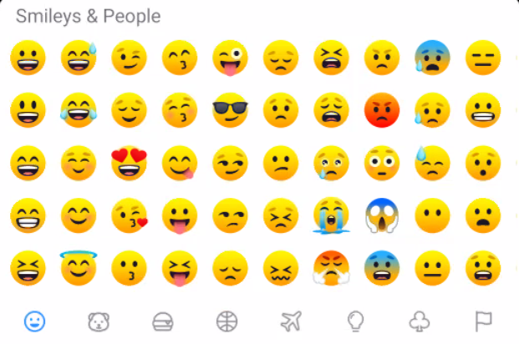
Zoom – Reactions
Use reactions to participate in meetings and show you are engaged even when muted.
Zoom desktop:
When in a meeting click the Reactions button and choose one.
You can also raise your hand to let the presenter know you have a question.
Zoom mobile:
When in a meeting click the More button.
The reactions are at the bottom and additional reactions can be found by clicking the 3 dots icon.
1
2
3

Slide 14
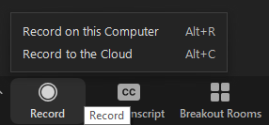
Zoom – Recording sessions
2 ways to record: Local and Cloud
Cloud only supported on Pro, Business, or Enterprise accounts.
Local the only option for Basic (free) accounts
Enable recording in your zoom web portal.
Once enabled you can adjust your settings in the zoom desktop app.
Recording settings:
Adjust local location to save local recordings on your computer.
Multiple options to choose how to manage your recordings.
Manage your cloud recordings (if supported by your account)
Recordings can be started, paused, and stopped during the meeting.
Recording is good for training meetings for attendees to watch later if they could not attend the live session.

Slide 15
Advanced Features

Slide 16
Zoom – Share your screen
Zoom desktop:
While in a meeting, click Share Screen and choose the screen you want to share.
If you have multiple monitors, it will put a number on each one to identify it and then choose the one that has the information you want to share in the meeting.
You can also choose to just share a certain application (word doc, PDF, Excel spreadsheet) instead of the whole screen.
You cannot share if someone else is sharing content. They must stop sharing first.
This feature can be customized in your settings.
Zoom mobile:
While in a meeting, click Share, you get a menu asking what you want to share.
You can share your screen, a photo, a document, a web URL, your camera, and more.

Slide 17
Zoom – Annotate
This feature allows you to add drawings or comments on your screen share or whiteboard session. It must be enabled by the host.
While in a meeting, click View Options at the top and then Annotate to show the available tools.

Slide 18
Zoom – Breakout Rooms
Breakout rooms are sessions that are split off from the main Zoom meeting. They allow the participants to meet in smaller groups. They are completely isolated in terms of audio and video from the main session.
Typically, the host will invite you to join a Breakout Room. You will get a pop-up that says, “You have been assigned to Breakout Room: <Room name>. Click Join Breakout Room button.
To leave the Breakout Room:
Click Leave Breakout Room.
Choose if you want to leave the breakout room or the entire meeting.
When the host ends the breakout rooms, you will be notified and given the option to return to the main room immediately, or in 60 seconds.
Asking for help in the room:
Click Ask for Help in the meeting controls and confirm that you would like assistance by clicking Invite Host.

Slide 19
Zoom – Waiting Room
Zoom desktop:
Open the Zoom app and click on the Settings cog in the upper right-hand corner.
Then click the View More Settings link at the bottom.
Under Security you will see a button to enable the Waiting Room.
Configure additional options under Waiting Room Options.
Edit Options: Edit who gets sent to the waiting room,
Customize Waiting Room: Allows you to edit the Waiting Room message and other settings that users will see while in the waiting room.
Zoom mobile:
Cannot be set from mobile app, you must access the web portal to turn on and customize this feature.

Slide 20
Zoom – Keyboard shortcuts
The full list of Zoom shortcuts can be seen on their support site here.
Here are some you may find useful to start with:
Alt+V: Start/stop video
Alt+A: Mute/unmute audio
Alt+M: Mute/unmute audio for everyone except host (Note: For the meeting host only)
Alt+Y: Raise/lower hand
PageUp: View previous 25 video stream in gallery view
PageDown: View next 25 video stream in gallery view

Slide 21
Additional Resources

Slide 22
Zoom – Additional Resources
Access your zoom account via the web: https://zoom.us/signin
Get support or read knowledge articles: https://support.zoom.us/hc/en-us
Learn more about Zoom via E-learning courses: https://learning.zoom.us/learn

Slide 23
Questions?

Slide 24
Thank You!

Slide 25
End logo slide

