Slide 1
Teams Tips & Tricks for Dress for Success
Minnesota Chapter – February 2022

Slide 2
Dell Technologies is a destination employer for women, where everyone drives to create an inclusive environment, and women are enabled to achieve their goals at each point in their journey.
VISION
MISSION
Build an inclusive community that provides development, leadership and networking opportunities designed to empower, retain and attract women.
PILLARS
Leadership and professional development, brand advocacy and business impact, community engagement, women in technology and culture.
Minnesota Chapter– since September 2018
107
members
Leadership opportunities
Professional development
Community service credits

Slide 3
Agenda
Basic Features
Q&A
Advanced Features
Additional Resources

Slide 4
Basic Features

Slide 5
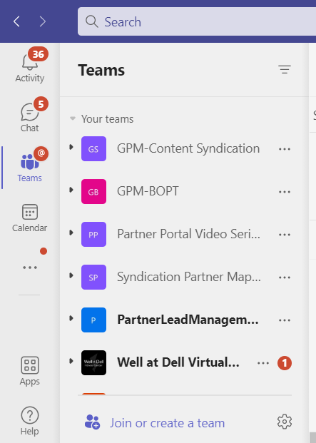
Teams
A team is group of all the people working on a project. It can range from few people to entire organization.
Creating a new team
Start in the Teams tab and click Join or create a team.
Select Create a team.
Select desired template or start one from scratch.
Give your team a name and add your collaborators individually with email aliases or as a group.
Teams can be public or private.
If Public – Anyone in your organization can join
If Private – Only team owners can add members

Slide 6
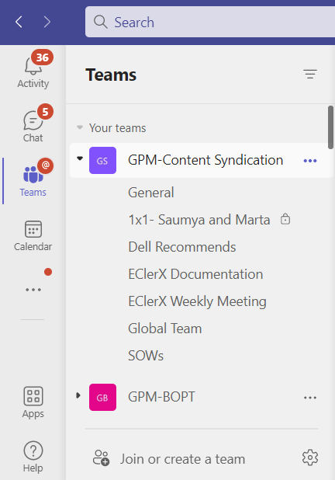
Channels
A team is made up of multiple channels, each dedicated to single focus area.
Creating a new channel within a team
Start by clicking on the 3 dots next to your team name and select Add Channel.
Give the channel a name and description.
Select privacy settings:
Standard – Everyone on the team has access.
Private – Specific teammates have access.
General Channel:
Each team has a General channel
Permissions can be set by clicking the 3 dots next to it and selecting Manage Channel. Options are:
Anyone can post messages
Anyone can post; show alert that posting will notify everyone (recommended for large teams)
Only owners can post messages.

Slide 7
Posts
Use Posts in channels to talk to your team and channel members.
Use threaded conversations to reply directly to a message, keeping the conversation organized.
At the top right corner of all messages in Channels, you have an option to like messages or save them for later. Saved messages will be kept in Saved along the left rail.
You can also bring people’s attention by @Mentioning them, just type the @ symbol before their name. And if you admin enables it, you can @mention your whole team or any channel.
Express yourself in your messages with emojis, GIFs, stickers, and memes.
Use other options from the top navigation to organize your documents and knowledge sharing.

Slide 8
Chat and Group Chat
For private conversations with your colleagues use the Chat function from navigation pane of your application.
Click on the ‘New Chat’ icon and search your colleagues name in the ‘To:’ box
You can add multiple people to convert this into a group chat

Slide 9
Chat Features
Format your message
Use text formatting options to make your message stand out
File Sharing
Use the paperclip button to share files from your OneDrive or Computer
Schedule a meeting
Schedule a meeting directly from chat

Slide 10
Chat Features
Conversation
Use audio or video call options to live conversate
Share Screen
Use audio or video call options to live conversate
Add members to conversation anytime
Use audio or video call options to live conversate
Pop out chat
Use this feature to continue working in teams while you chat

Slide 11
Calls
Calls can be made via audio or video
Phone tab:
Shows your call history
Can change view to All, Missed, Incoming, or Voicemail
Type a name to call someone and click Call button
You can add people to speed dial for quick call access
Contacts tab:
Browse contacts
Add contacts

Slide 12
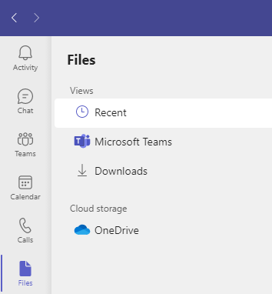
Files
Views:
Recent: Shows files you recently viewed or edited
Microsoft Teams: Shows files recently created/edited in channels in your teams list
Downloads: Shows files downloaded in Teams. List is cleared each time you log out.
Cloud Storage:
One Drive: Gives you access to your files on your One Drive from within Teams.
Could show other cloud storage services you have connected to Teams
Tip: Another way to view your recent files is to enter /files in the command bar at the top of teams!

Slide 13
Schedule a Teams meeting
Click on Calendar from the left pane of your Teams application
Click on New meeting and fill in details to schedule your meeting

Slide 14
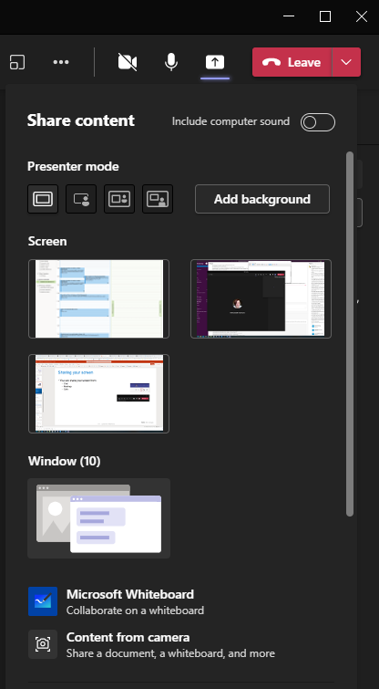
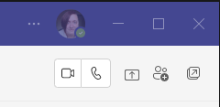
Sharing your screen
You can share your screen from:
Chat
Meetings
Calls
Once you click the share button you are asked what content you want to share.
A screen
A window
Whiteboard
Content from camera

Slide 15
Advanced Features

Slide 16
Access via Web or Phone
Access via web
Go to teams.microsoft.com and login with your Microsoft credentials or business account credentials.
Access via phone
Teams app is available for both Android and iOS users.
Download the Teams app from your Play Store or Apple App Store.
Login with your Microsoft credentials or business account credentials.
To sign out of the app, go to the menu in the top left-hand corner /settings / sign out.

Slide 17
Search across conversations
Type your search in the search box in the top and press Enter. The search results will appear in the left pane.
Narrow your search results by messages, people, or files
More info on how to use search in Teams:
https://support.microsoft.com/en-us/office/search-for-messages-and-more-in-teams-4a351520-33f4-42ab-a5ee-5fc0ab88b263

Slide 18
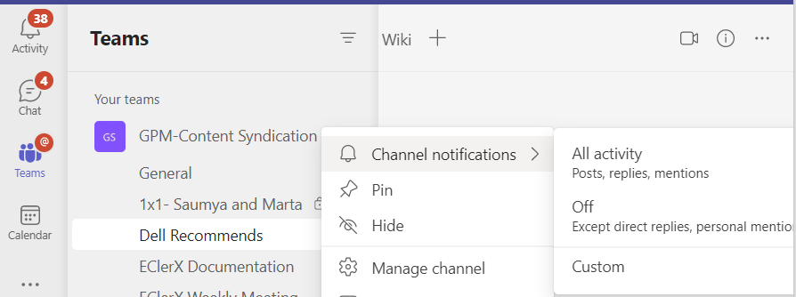
Disable Notifications
Take control of notifications and avoid frequent distractions.
Hover over the channel you want to update.
Click the ellipsis (…) next to the channel.
Click Channel notifications.
Click the All activity, Off, or Custom option to update your notification settings.

Slide 19
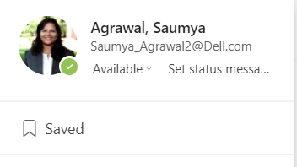
Follow up using saved conversations
Teams gives you the ability to save conversations to follow up later.
How to save a message
Hover the message and then click the ellipsis (…).
Click Save this message.
How to view saved message
Click on your picture on top-right corner and click saved.
Your saved messages will show up on the left side of your app.
Or,
Type /Saved in the search box at the top of Teams and press Enter to view your saved messages.

Slide 20
Email to a Team Channel
You can email your entire team or a channel by getting an email address of your team
How to get the email address of a channel
Hover the channel then click the ellipsis (…) next to the channel. Click Get email address.
Click the Copy button. Open your email tool and paste the email address.
To manage you should be able to email your channel, click on advanced settings and select desired option.

Slide 21
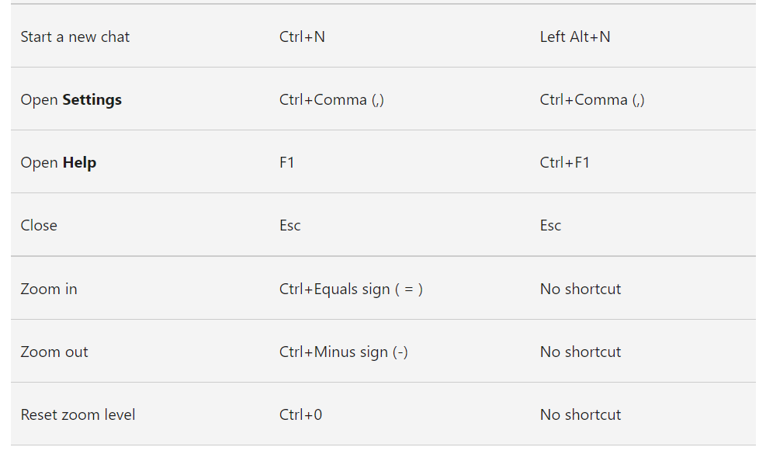
Keyboard Shortcuts

Slide 22
Additional Resources

Slide 23
Additional Resources
Microsoft Teams Docs and Learning resources:
https://docs.microsoft.com/en-us/learn/teams/
https://support.microsoft.com/en-us/teams?ui=en-us&rs=en-us&ad=us
Microsoft Teams feedback:
https://feedbackportal.microsoft.com/feedback/forum/ad198462-1c1c-ec11-b6e7-0022481f8472
Download Microsoft Teams:
https://www.microsoft.com/microsoft-teams/download-app

Slide 24
Questions?

Slide 25
Thank You!

Slide 26
End logo slide

