Slide 1
Google Tips & Tricks (part 1) for Dress for Success
Minnesota Chapter – March 2022

Slide 2
Dell Technologies is a destination employer for women, where everyone drives to create an inclusive environment, and women are enabled to achieve their goals at each point in their journey.
VISION
MISSION
Build an inclusive community that provides development, leadership and networking opportunities designed to empower, retain and attract women.
PILLARS
Leadership and professional development, brand advocacy and business impact, community engagement, women in technology and culture.
Minnesota Chapter– since September 2018
107
members
Leadership opportunities
Professional development
Community service credits

Slide 3
Agenda
Google Search
Q&A
Gmail
Google Calendar
GQueues

Slide 4
Google Search

Slide 5
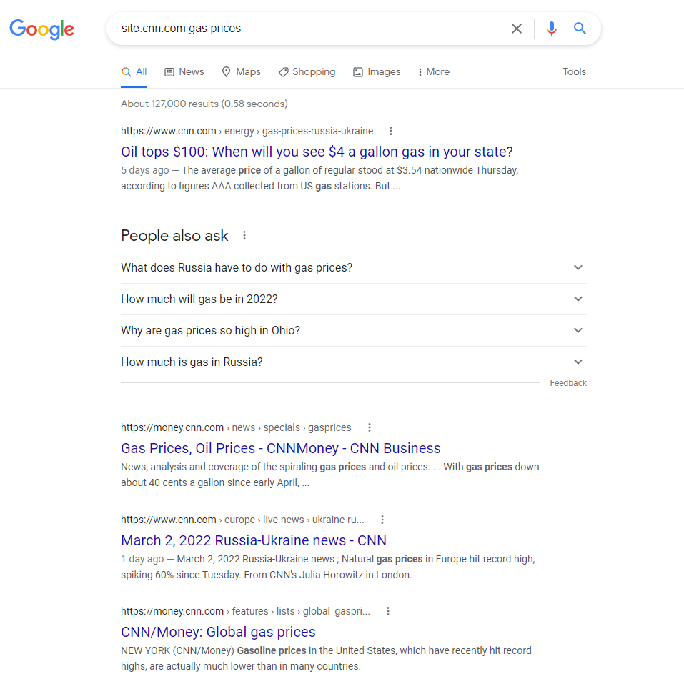
Google Site Search
Want to search a certain site for keywords?
Use Google Site Search
Here are some examples:
site:cnn.com gas prices
site:facebook.com Robert Downey Jr
site:Wikipedia.com artificial intelligence

Slide 6
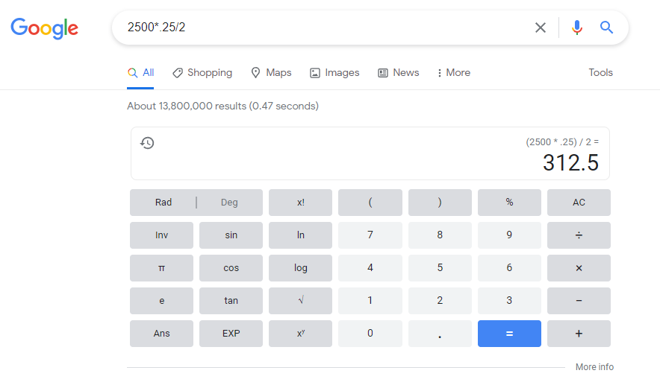
Google Calculator
You can type a formula into the search bar to do your calculations for you without opening your calculator on your computer.

Slide 7
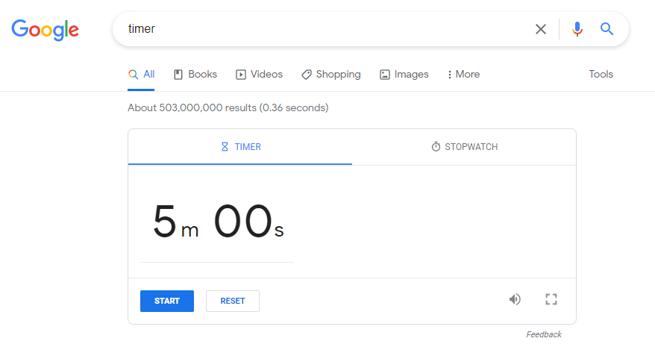
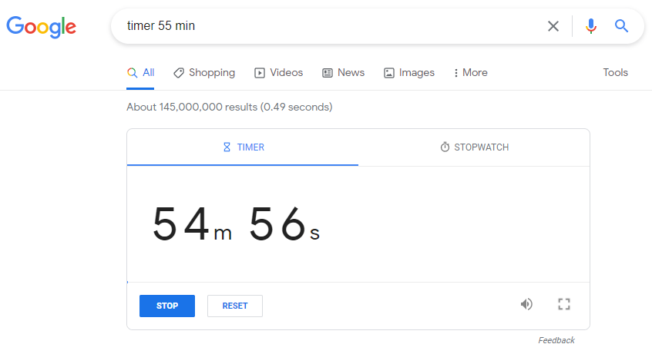
Set a Timer
Just type timer into the search to launch an embedded timer tool
Default is 5 minutes.
Enter the time you want to set and click start.
There is also a stopwatch option
If you want to set a timer for 55 minutes type: timer 55 min
It will start counting down immediately.
It will make a loud beeping sound when it hits zero. Make sure your speakers are turned on!

Slide 8
Convert Time Zones
Need to setup a meeting with people in a different time zone?
Google is great at identifying time zones or converting time.
Here are some examples you can try:
What time is it in Paris?
convert 7:30am to Paris
convert 8:30 am ist to cst
convert 7:00 am est to pst

Slide 9
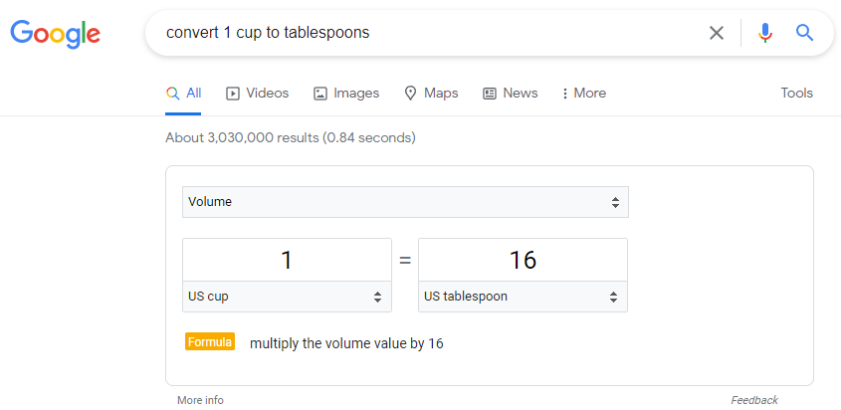
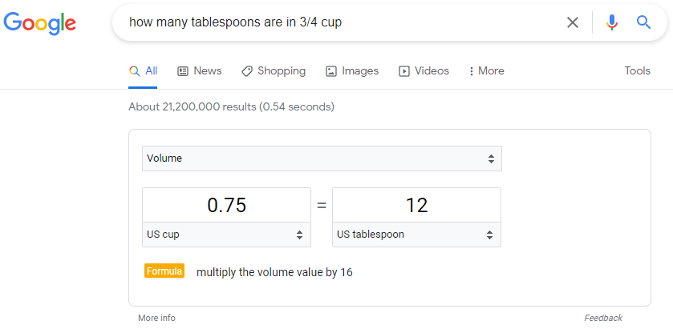
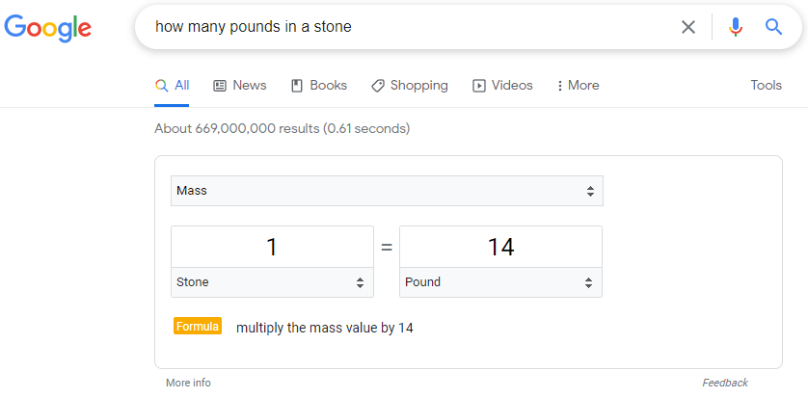
Conversions and Measurements
There are so many ways you can use the convert feature. Here are some examples:
Miles to Kilometers
Tablespoons to Cups
Pounds to Stone
Ounces to Grams
Maybe you need to know how many teaspoons are in ½ cup.
This feature is also available in the Chrome mobile browser

Slide 10
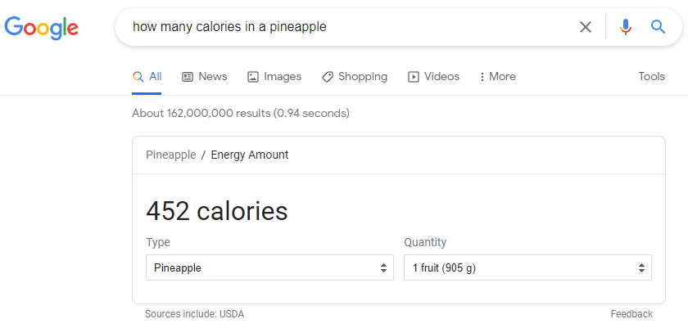
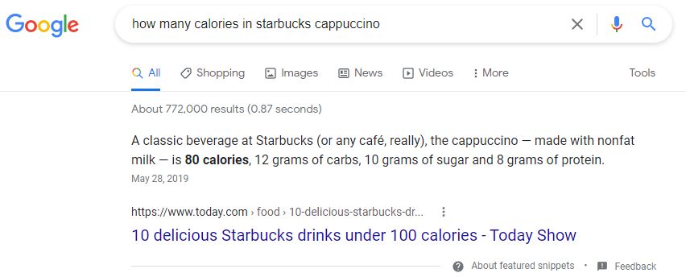
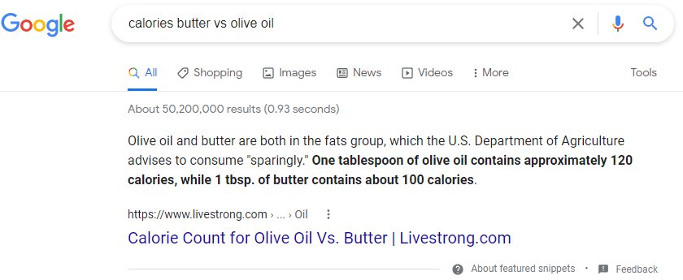
Get nutritional information
You can check calorie content and nutritional information for foods via Google search.
You can compare the calories in different foods too.
Try it using this format: calories apple vs orange
Search for your favorite foods and see what you find.

Slide 11
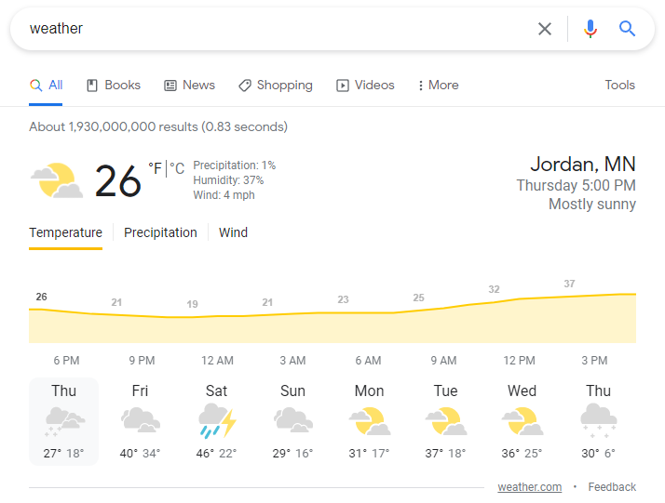
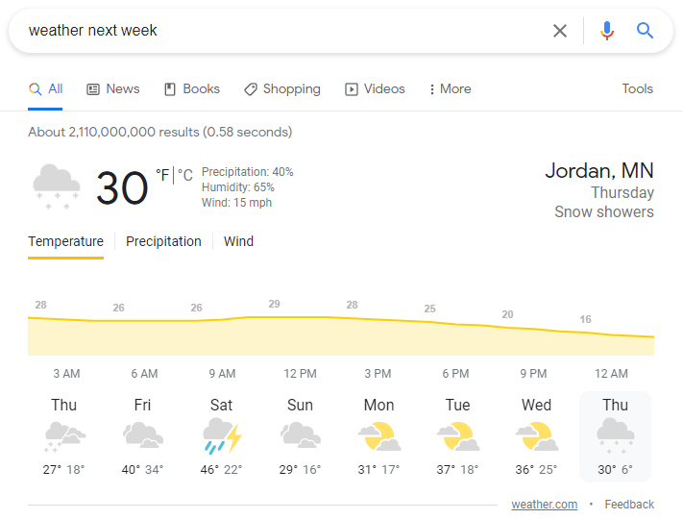
Check the weather
Type weather to get the current local forecast
Type weather next week to get the future forecast
Fun fact: Type earthquake to get a full report on recent earthquakes.

Slide 12
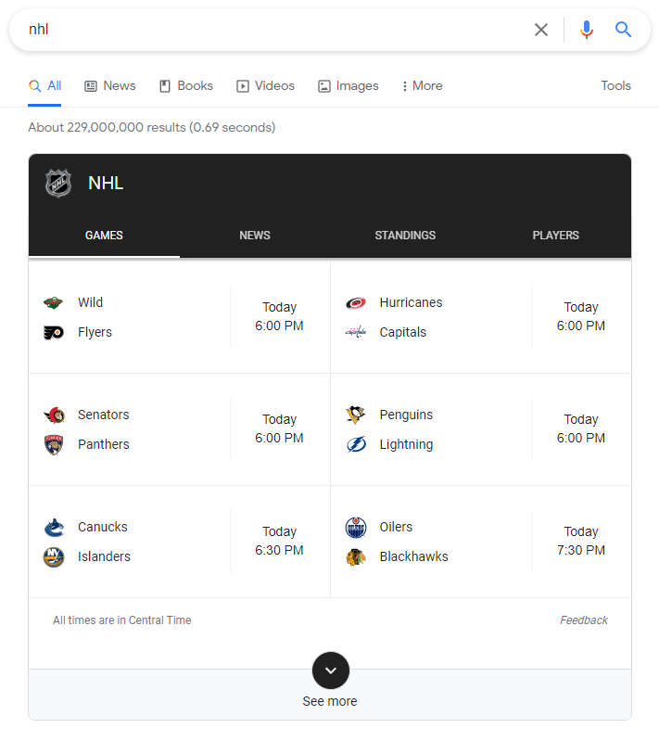
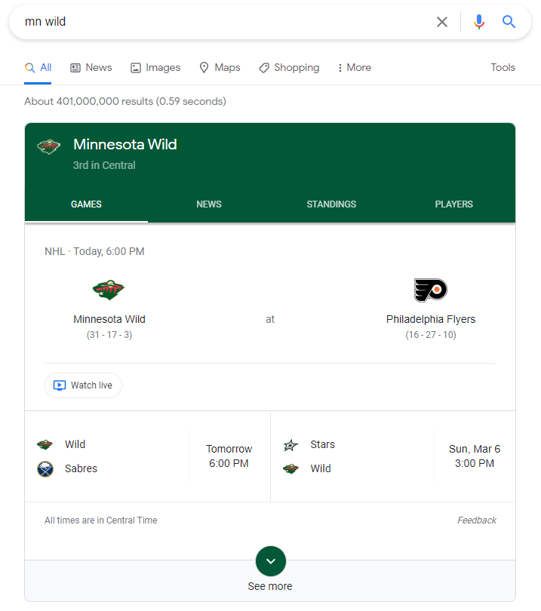
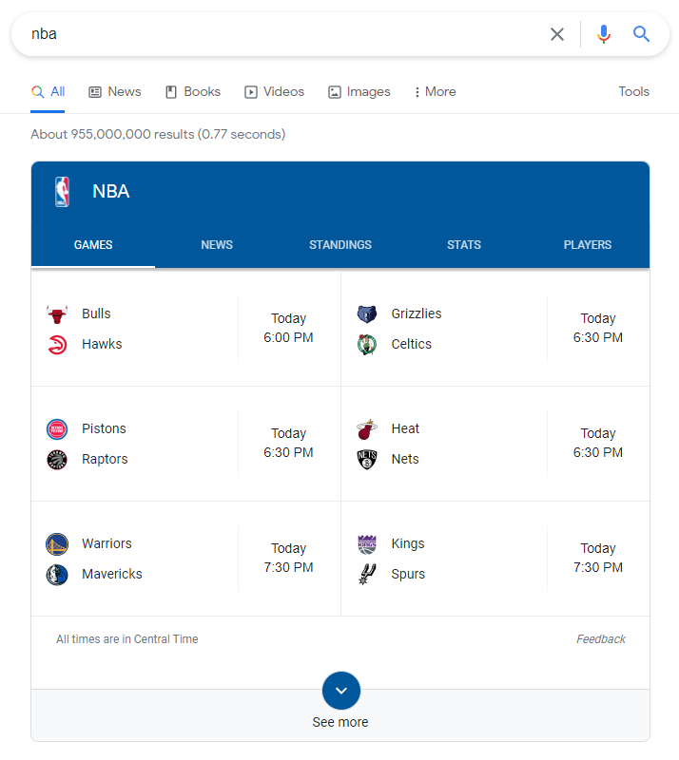
Check Sports info
Type a sport league into the search to get upcoming games and recent game scores.
Search a team name to get specifics for that team.

Slide 13
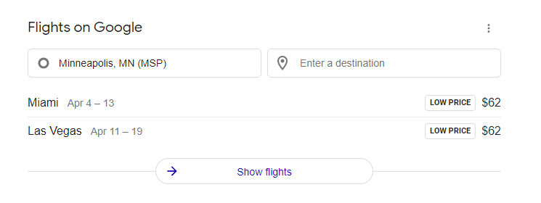
Check Flights
Just search the word flights in the search bar
Enter a destination or click Show flights to get more information
Notes:
Need to know flight times for your local airport?

Slide 14
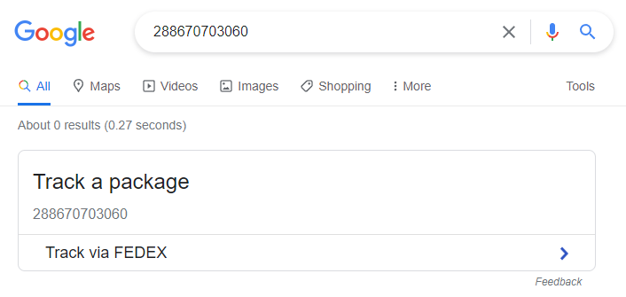
Track Packages
To track your packages, simply enter a tracking number into the search bar.
This brings up the Track a Package app with your tracking number in it.
Click the Track link to see the tracking details through the delivery provider.
280172145780
280172145780

Slide 15
Fine tune your searches
Exclude words or phrases from search results using the – option
Link words using AND or + sign. (Example: sun AND moon or sun +moon)
Search a whole phrase using quotes
Use pipe (|) or OR to create a search for either word
Use asterisk (*) to represent a missing word
Use (~) to search for synonyms of a word
Use 2 dots between numbers to represent a range. (Example: world series1994..1998)

Slide 16
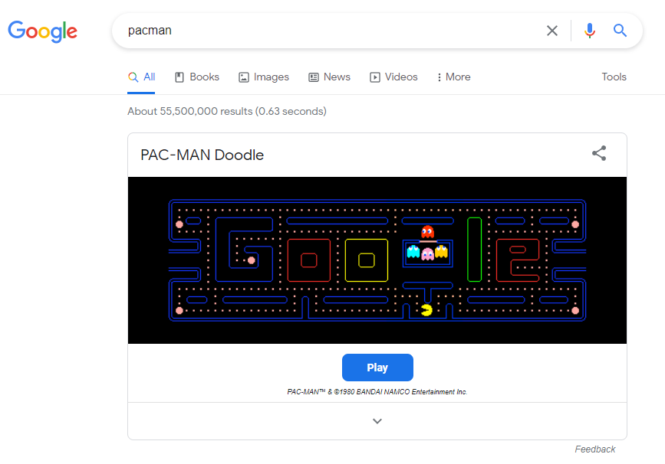
Pac-man
Are you a pac-man fan? Type pacman in the search bar to play a quick game!

Slide 17
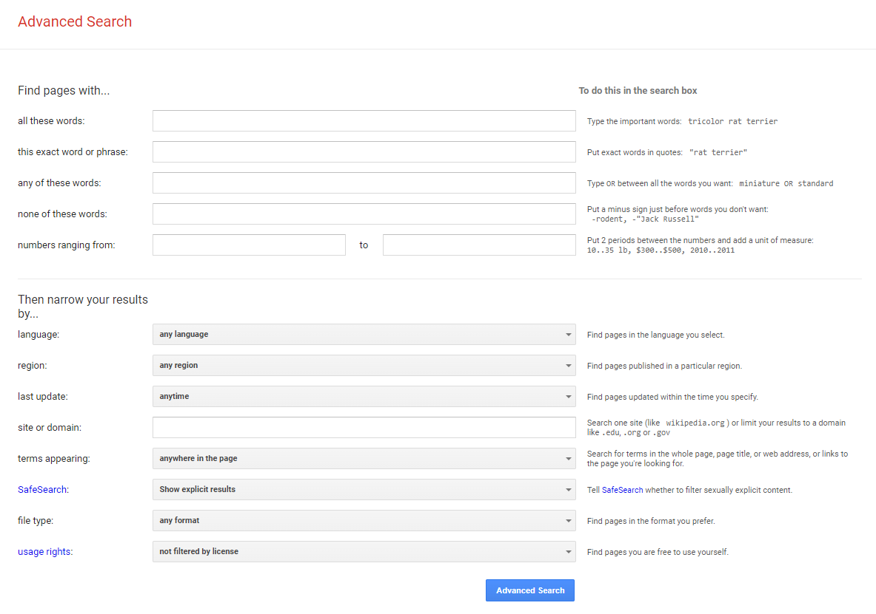
What else?
Google can also do the following:
Translate words or phrases
Find movie show times
Search by image or voice
Advanced search
type Advanced Search Google in the search bar
Find word definitions, synonyms, and antonyms
Tell you sunrise and sunset times
Give you stock quotes

Slide 18
Gmail

Slide 19
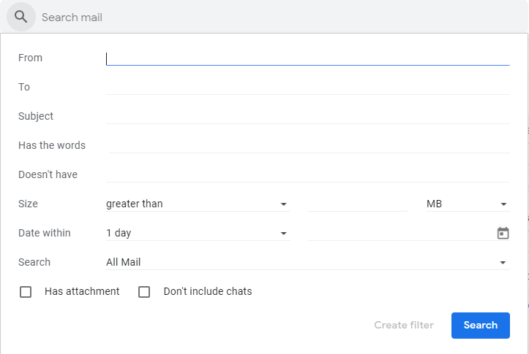
Gmail Search
Gmail has over 20 search operators you can use to find messages or create filters.
Find emails by sender using from:
Find emails by recipient using to:
Search by keyword
Use advanced search by clicking the filters button

Slide 20
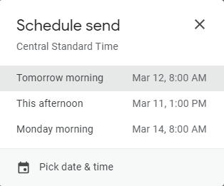
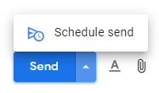
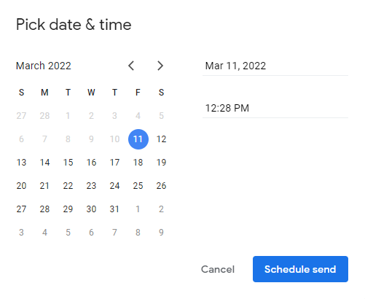
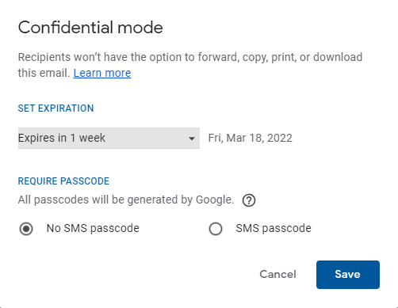
Email send features
Undo Send (unsend messages)
Click Settings > See all settings
Next to Undo Send choose the cancellation period
Choices are 5, 10, 20, or 30 seconds
Scroll down & click Save Settings
Schedule Send
Compose an email and click the up arrow on Send button
Schedule options:
Choose a pre-selected time in the list
Click Pick date & time to select a specific date and time
Confidential mode
Set options to destroy the email automatically
Require a SMS passcode to view the email
Notes:
Undo Send:
Ever hit send and realize you had a mistake in an email? Maybe you had the wrong recipients included on the CC line. In Gmail the Undo sent option allows you to recall messages up to 30 seconds after you send them depending on your settings.
Schedule Send:
Want to make sure an email is received at a certain time? Maybe you have a colleague in another time zone and you want to be sure they see your email first thing in the morning. To make sure it is not buried in other emails you can schedule it to be sent at a certain time.
Confidential Mode:
Recipients won’t have the option to forward, copy, print, or download the email. You can set a specific expiration and require a passcode

Slide 21
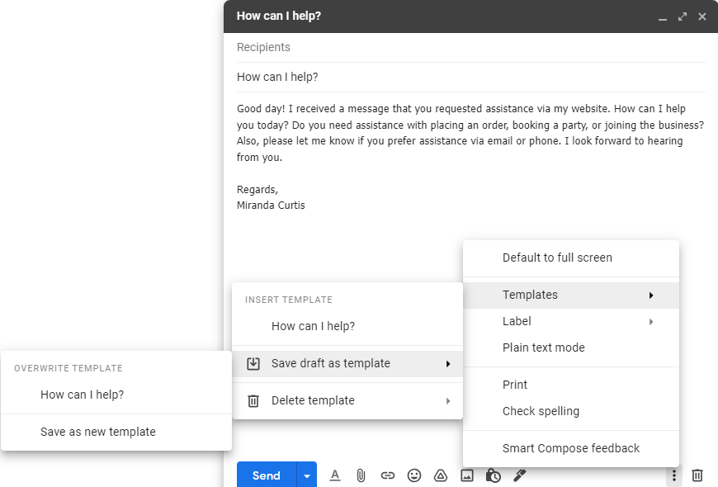
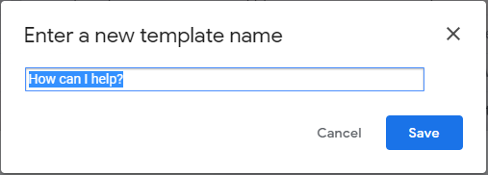
Email templates
Go to Settings > See all settings > Advanced
Click Enable radio button in Templates section
Compose an email to save as a template
Once the draft is complete, click the 3 dots at the bottom
Choose Templates > Save draft as template > Save as new template
Enter a name for the template
To use the template
Click Compose and click the 3 dots
Select Templates > Under Insert Template select the Template Name to use
Just add recipient, any additional info, and click Send!
Notes:
Do you send a lot of emails with the same basic information? Templates are an easy way to save you time!

Slide 22
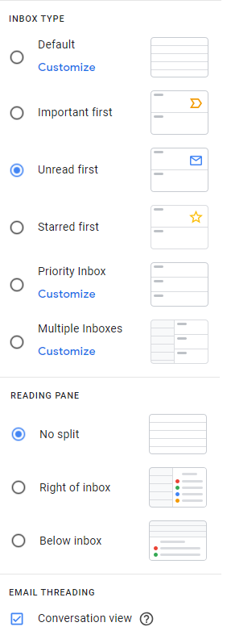
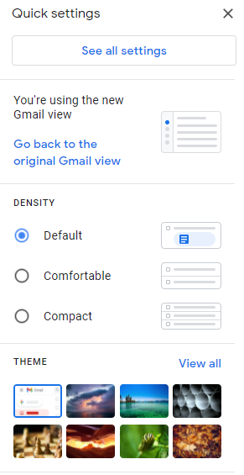
Gmail customize settings
Ways to customize your view:
Density: Default, Comfortable, or Compact
Inbox Type: Default, Important First, Unread First, Starred First, Priority Inbox, or Multiple Inboxes
Reading Pane: No split, Right of Inbox, or Below Inbox
Themes
Conversation View
Customize your experience
Display language
Default text style
Signature
Chat & Meet view
Spelling, grammar, and predictive text
Check out all the customizable settings!

Slide 23
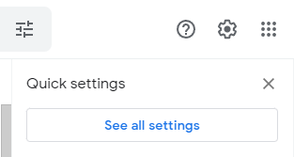
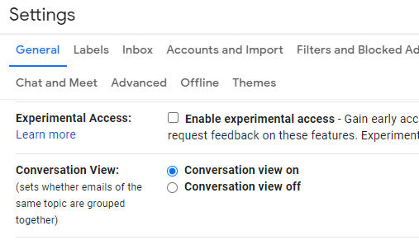
Conversation View
Keep emails in a thread together
To enable or disable:
Click Settings > Email Threading > Check/Uncheck Conversation View box
Click Settings > Click See All Settings > General > Scroll to Conversation View > Select Conversation view on/off

Slide 24
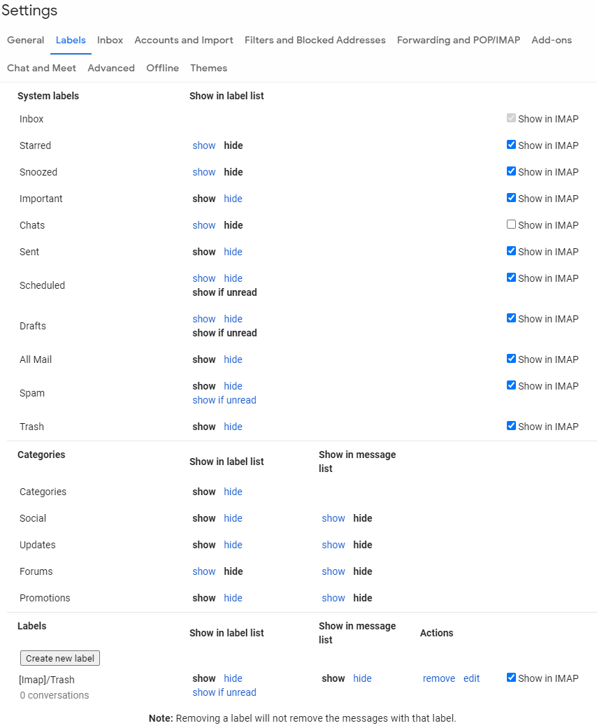
Remove Unwanted Tabs & Labels
Gmail automatically comes with Primary, Social, and Promotions tabs displayed
You remove or add additional tabs:
Go to Settings > See all settings > Labels
Under the Categories section click show or hide depending on your preferences.
Adjust the labels shown:
Go to Settings > See all settings> Labels
Show or hide system labels
Create new labels:
Click Create new label at bottom of Settings > Labels
Click the + next to Labels in the left navigation frame

Slide 25
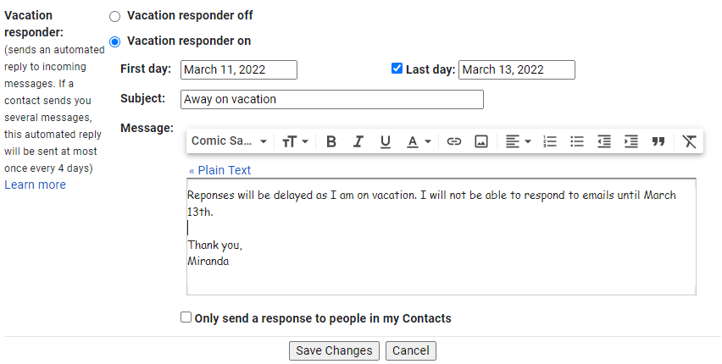
Vacation Responder
To enable:
Click Settings > See all settings
Scroll down to Vacation Responder
Select the Vacation Responder on radio button
Select the day it starts (required)
Select the day it ends (optional)
Enter a subject and Message
Select to send only to your contacts the check box.
Click Save changes
Once enabled, a banner will display in Gmail
Click End now to disable responses immediately
Notes:
Setup automatic replies during your vacations.
You can restrict this to reply only to those in your Contacts or allow to everyone.
This can be helpful if you are waiting for an email from someone that will require a response.
This feature can inform them that you are away and when they can expect a response.

Slide 26
Share access to Gmail
To grant access to your account:
Click on Settings > See all settings
Click Accounts and Import
Under Grant Access to your account:
Click Add another account
Enter the Google email address of the user you want to allow
Click Send email to grant access button to confirm
Notes:
The person you added will get an email asking them to confirm. It may take up to 24 hours for you to see them as a delegate after they confirm.
Note: This invite expires after one week.

Slide 27
Google Calendar

Slide 28
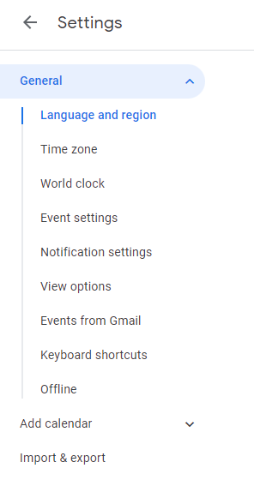
Calendar settings
Customize your settings based on your needs
You can enable world clock with specific locations
Super helpful for scheduling meetings with people in other countries.
Customize your notification settings
Set correct reminders for upcoming events based on need
Customize your default event settings
Customize your view
Enable desktop notifications
Google Calendar mobile app syncs with Android and IOS!

Slide 29
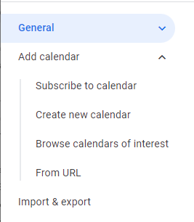
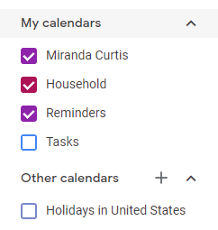
Importing Calendars
You can have many calendars
Import a family birthdays calendar
Import a client’s shared calendar
Google has a variety of free calendars
Regional Holidays
Global religious holidays
Sports
Phases of the moon
Add a Calendar:
Subscribe to calendar
Create New
Browse Calendars of Interest
From URL
Import from your computer

Slide 30
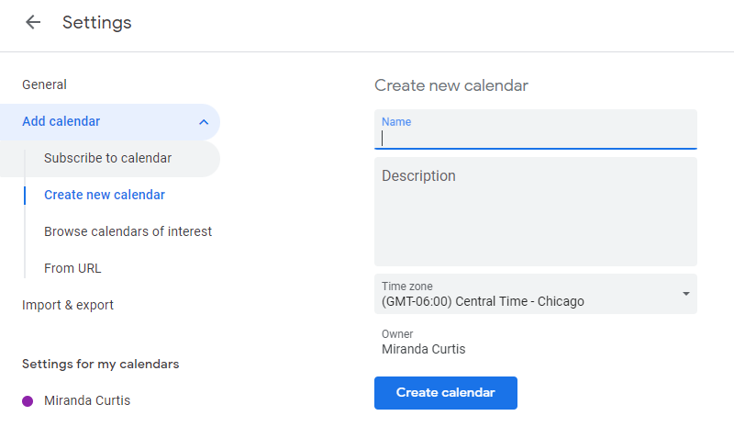
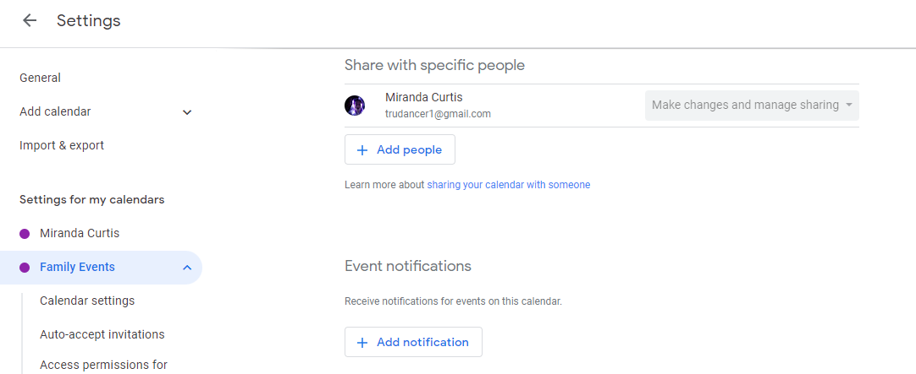
Sharing Calendars
Sharing calendars can be helpful for managing your family’s schedule:
It is very simple to do
Makes planning and coordinating easier
Decreases phone calls to double-check on schedule
New events added are instantly shared with members
Manage & Share
Family trips
Medical and Dental appts
Upcoming events & celebrations

Slide 31
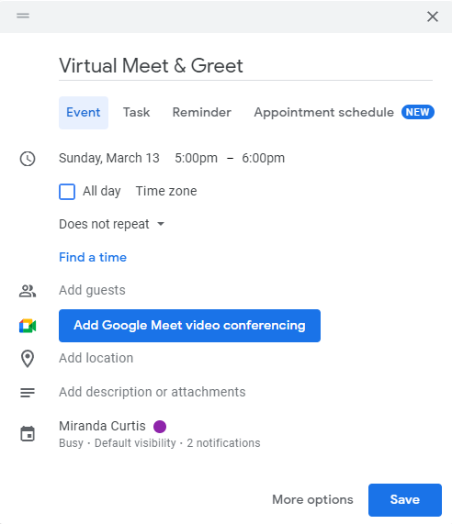
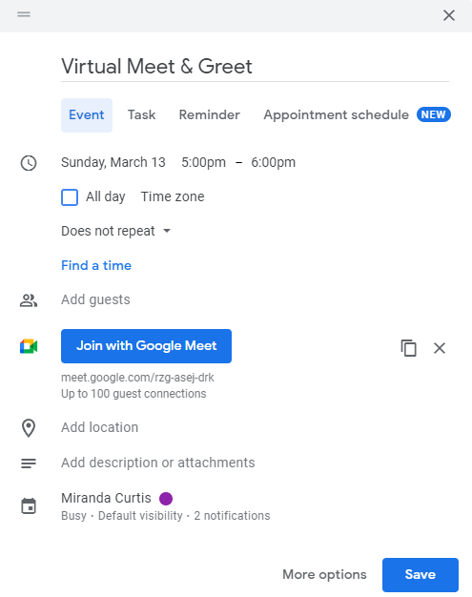
Meetings
Use “Find a time” to pick a time that works for all
Only works if all invitees are using Google Calendar.
Once selected, the system shows you the schedules of each participant.
Use Google Meet to host a video conference
Adds a video link that can hold up to 100 participants.
Click Add Google Meet video conferencing
Auto creates a link for the meeting
Appointment schedule
Available with Google Workspace Individual
You can have your own professional booking page so people can see your availability and book an appointment with you.
This is a premium feature.
Learn more here.

Slide 32
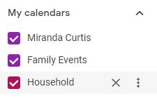
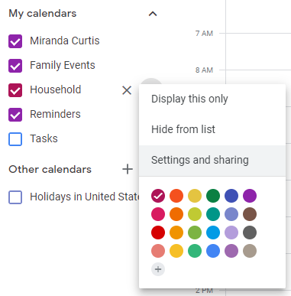
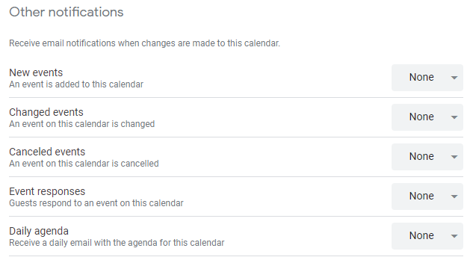
Daily Agenda
Google calendar can provide a daily agenda for the day for any calendar you choose.
To enable this:
Find the calendar you want a daily agenda for in the left frame.
Click the 3 dots next to it
Click Settings and sharing
Under Other notifications, find Daily agenda and change the drop-down to Email.

Slide 33
Keyboard Shortcuts
Enable these in Settings
Here's a sample of some helpful keyboard shortcuts:
Search: shift + /
Create event: c
Scroll to previous date range: k or p
Scroll to next date range: j or n
Jump to today: t
Delete event: Backspace or Delete
Switch views to:
Day: 1 or d
Week: 2 or w
Month: 3 or m
7 days: 4 or x
Agenda: 5 or a

Slide 34
GQueues

Slide 35
GQueues
This tool is used for managing work
Allows you to set tasks for yourself or your team
Collaborate on projects with others
Categories group tasks
Create teams for collaborative work
Queues are lists of tasks within categories or teams
Can create subtasks to break work into manageable chunks
Free and paid accounts available
Integrates with Google calendar for deadlines and reminders
Check it out at www.gqueues.com
Notes:
Teams allow you to:
Invite others
Prioritize work
Delegate tasks

Slide 36
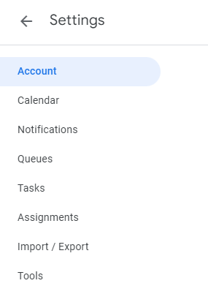
GQueues
App for Android and IOS
Customize settings for your needs
Enable celebrations when achievements are reached
Chrome extension to create tasks as you think of them from any web page.
Install GQueues on your Google account to open it from Apps menu
Export data to a CSV file for backup
Team Queues and Shared Queues must be exported separately
Google workspace Add-on
Manage tasks directly inside Gmail, Google Calendar, and Google Drive

Slide 37
Questions?

Slide 38
Thank You!

Slide 39
End logo slide

